Slide 1
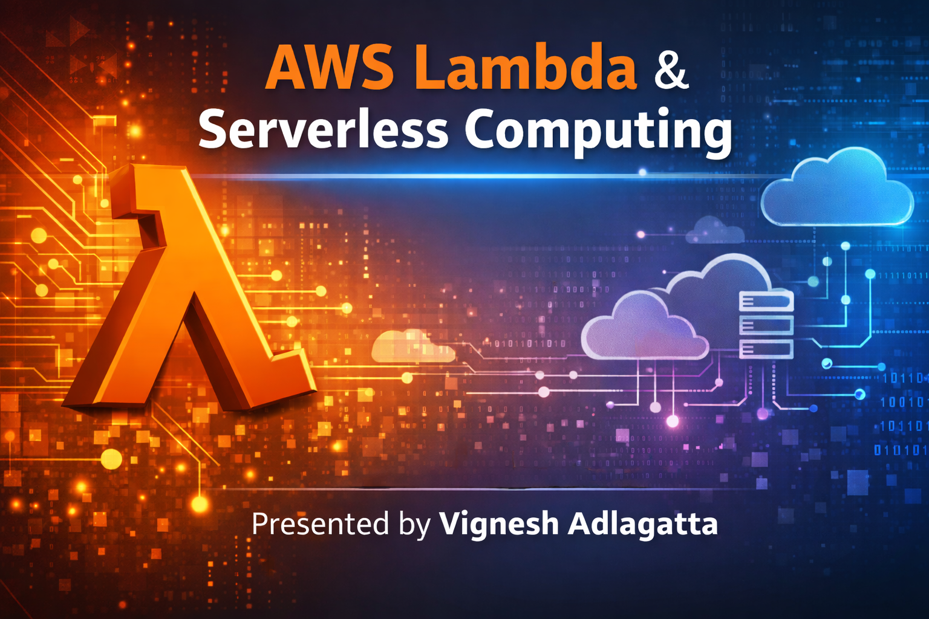
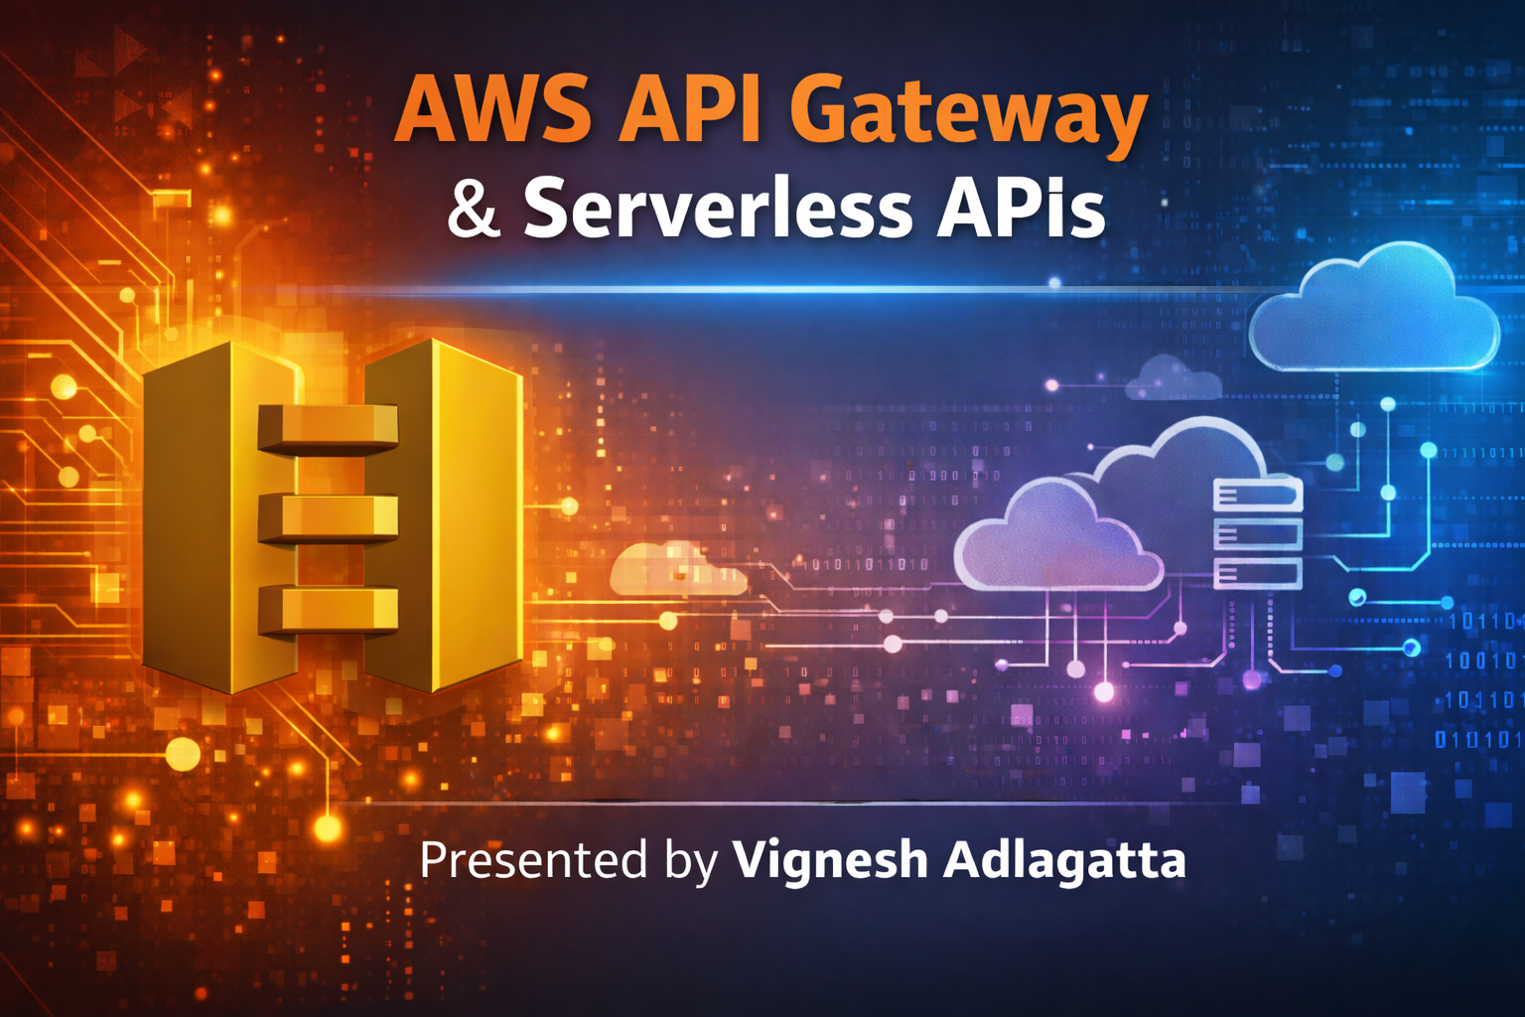

Slide 2
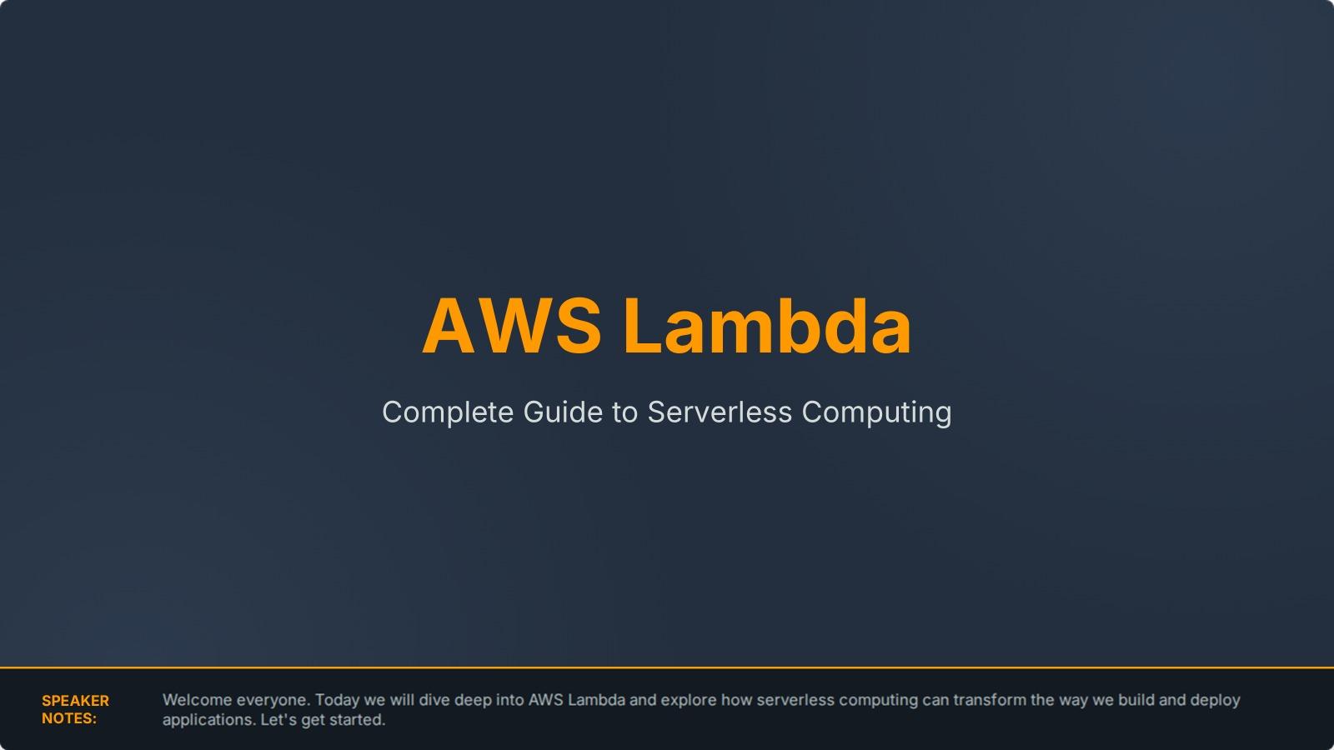

Slide 3

Agenda
Module 1: Cloud & Serverless Basics
Module 2: AWS Lambda Fundamentals
Module 3: Lambda Console Walkthrough
Module 4: Configuration & Performance
Module 5: Monitoring and Troubleshooting
Module 6: Security Best Practices
Module 7: Real-world Applications
SPEAKER NOTES:

Slide 4
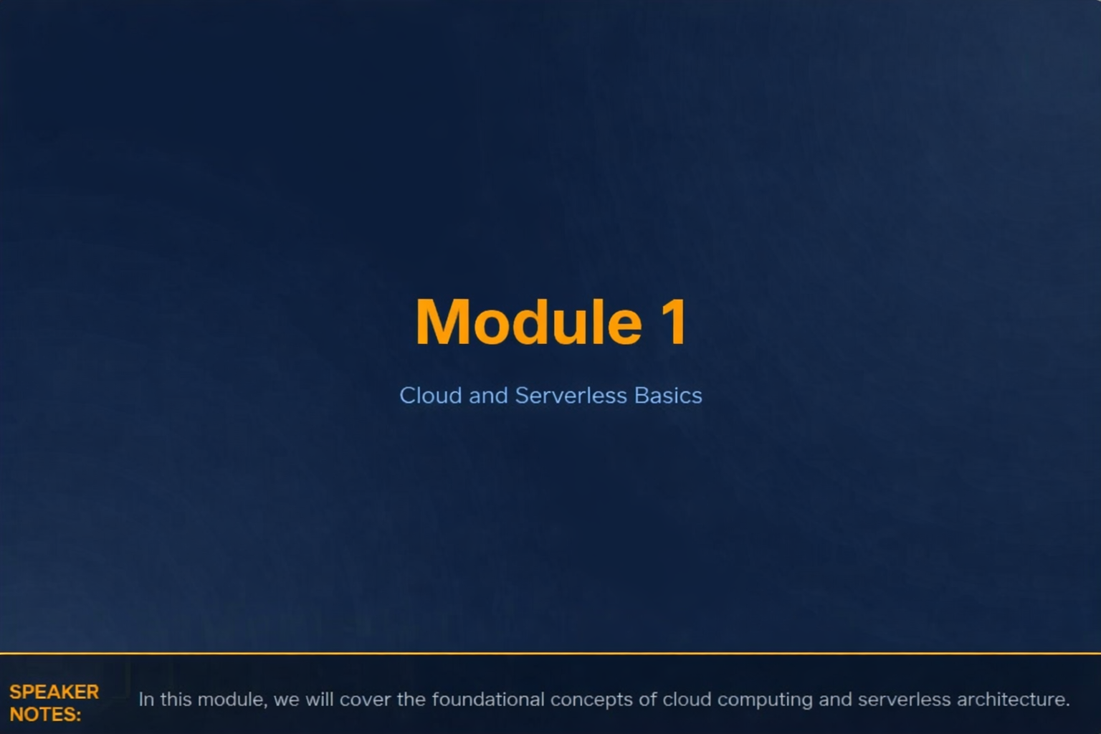

Slide 5
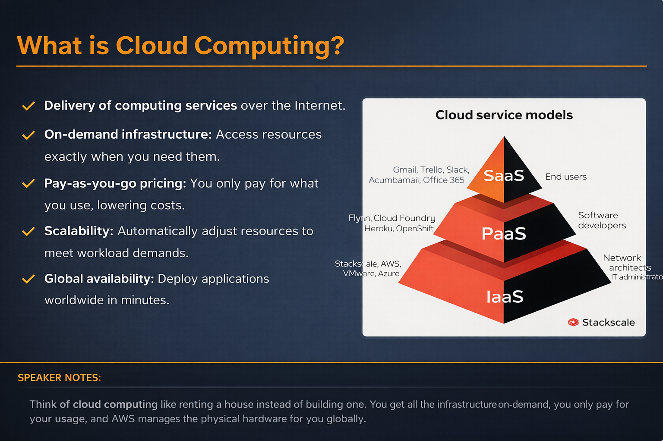

Slide 6





Types of Cloud Services
IaaS
PaaS
FaaS
Infrastructure as a Service. You manage the OS, runtime, and data. Example: Amazon EC2.
Platform as a Service. AWS manages the underlying infrastructure. Example: AWS Elastic Beanstalk.
Function as a Service. You only write the code. No servers to manage. Example: AWS Lambda.
SPEAKER NOTES:

Slide 7


What is Serverless Computing?
No Server Management
Event-Driven & Auto-Scaling
You never have to provision, maintain, or administer servers. AWS handles all hardware and operating system maintenance, patching, and capacity provisioning.
Code runs only in response to triggers (events). The system automatically scales from zero to thousands of concurrent requests seamlessly, and you pay only when code runs.
SPEAKER NOTES:

Slide 8








Benefits of Serverless
Low Operational Cost
Automatic Scaling
High Availability
Pay only for the compute time you consume down to the millisecond.
Scales continuously based on individual requests.
Built-in fault tolerance and availability across multiple zones.
Faster Development
Focus strictly on business logic rather than infrastructure tasks.
SPEAKER NOTES:

Slide 9
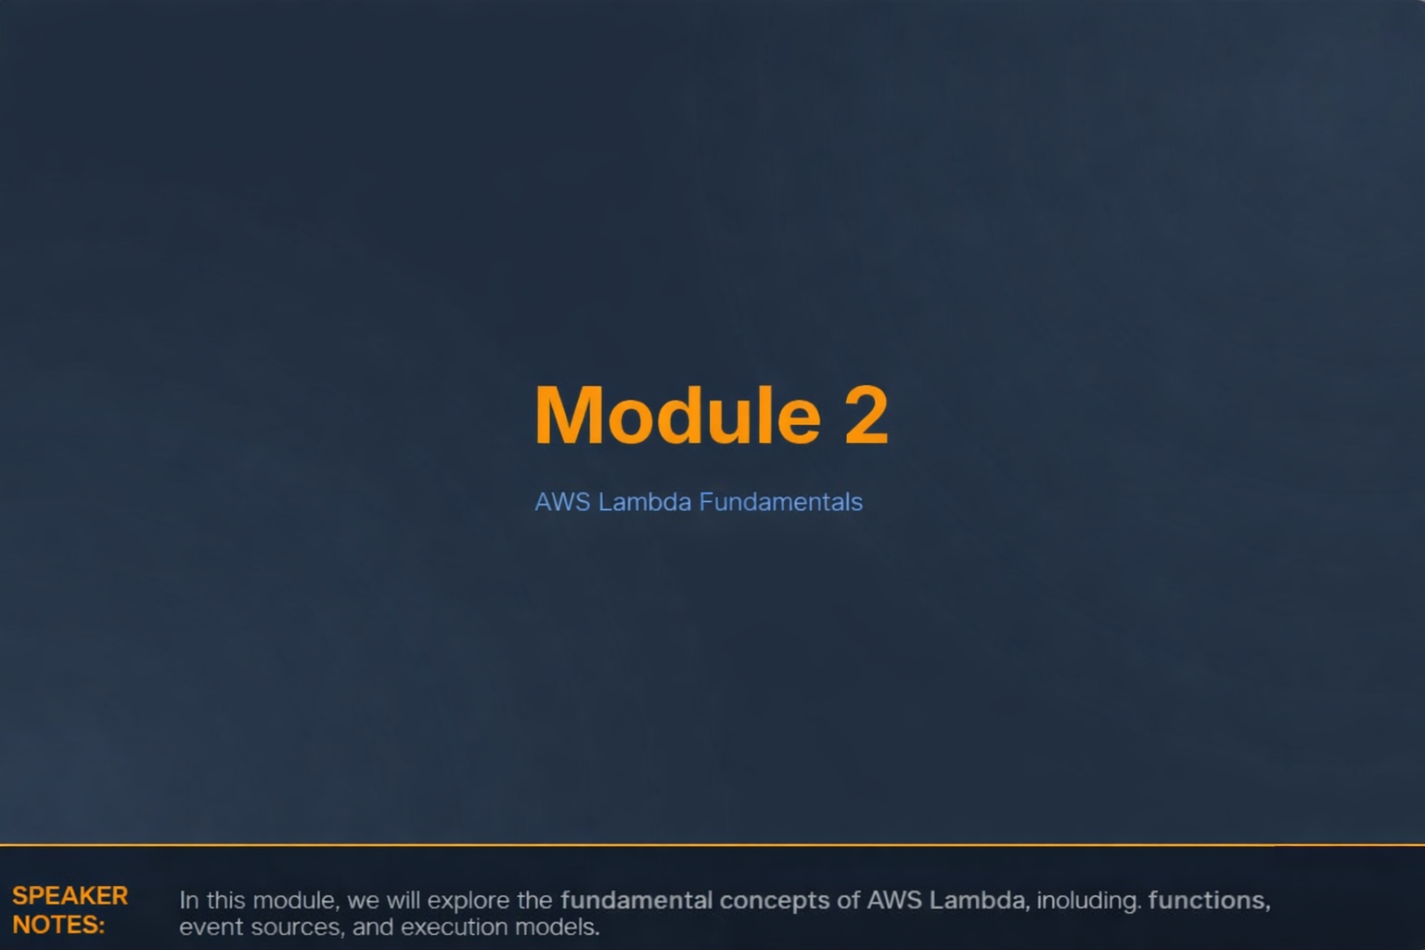

Slide 10

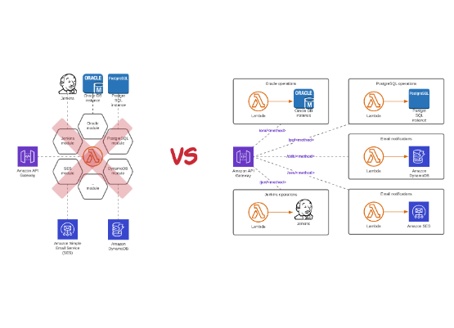
What is AWS Lambda?
Definition: AWS Lambda is an event-driven, serverless computing service provided by Amazon.
Runs code without provisioning or managing underlying servers.
Automatically executes code only when triggered by specific AWS events.
Handles all capacity, patching, and administration seamlessly.
SPEAKER NOTES:

Slide 11








Supported Languages
Python
Node.js
Java
Excellent for scripting, data processing, and automation.
Perfect for asynchronous, event-driven applications.
Great for enterprise-level backend services.
Go
C# (.NET)
Ruby
High performance and minimal cold start times.
Ideal for migrating existing Windows workloads.
Fast development for web applications and scripts.
SPEAKER NOTES:

Slide 12
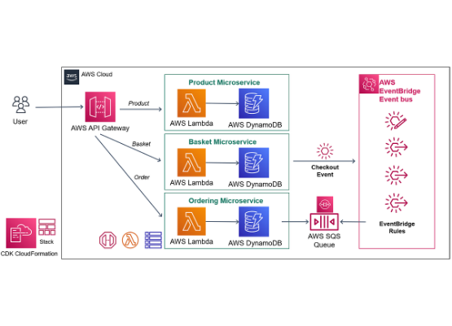
Lambda Architecture Diagram
Client: User makes a request via web or mobile app.
API Gateway: Acts as the front door, receiving the HTTP request.
AWS Lambda: Executes business logic triggered by the API Gateway.
DynamoDB: Lambda interacts with the database to read/write data.
SPEAKER NOTES:

Slide 13
Event-Driven Architecture
Lambda is fundamentally event-driven; it waits for a trigger to execute.
HTTP API request: Triggered via API Gateway or Application Load Balancer.
File upload to S3: Image processing triggered when a file is saved to a bucket.
Database update: DynamoDB Streams trigger Lambda upon data modification.
Scheduled task: EventBridge triggers code on a cron-like schedule.
SPEAKER NOTES:

Slide 14
Lambda Execution Flow
2. Invocation
4. Response
AWS Lambda is automatically invoked by the service.
Code completes, returns a response, and resources are freed.
1. Event Occurs
3. Execution
A trigger fires (e.g., user uploads an image to S3).
Lambda provisions compute resources and runs your code.
SPEAKER NOTES:

Slide 15





Lambda Components
Function
Runtime
Handler
The actual script or code package you upload to AWS to perform the logic.
The language-specific environment that runs your function (e.g., Python 3.10).
The specific method in your code that Lambda calls to start execution.
Event Object
Execution Role
JSON-formatted data passed to your function containing request details.
The IAM role granting Lambda permission to access other AWS services.
SPEAKER NOTES:

Slide 16
Module 3
AWS Lambda Console Deep Dive
SPEAKER NOTES:

Slide 17
Lambda Console Overview
Functions: The main dashboard to view, create, and manage all your Lambda functions.
Applications: Group multiple functions and resources into serverless applications.
Layers: Manage shared code libraries and dependencies outside your deployment package.
Code Editor: A built-in IDE to write and edit function code directly in the browser.
Configuration Tab: Manage triggers, permissions, environment variables, and memory.
SPEAKER NOTES:

Slide 18


Function Overview Panel
Identity & Status
Metadata
Function Name: The unique identifier for your resource. Function ARN: Amazon Resource Name, used to reference the function globally across AWS.
Runtime: The active language version (e.g., Node.js 18.x). Last Modified: Timestamp of the most recent code or configuration deployment. Handler: The configured entry point for execution.
SPEAKER NOTES:

Slide 19


Code Deployment Options
Inline Editor
Upload ZIP File
Container Image
Write and edit code directly in the AWS Management Console. Best for quick tests and small functions.
Package your code and dependencies locally, then upload via console or CLI. Standard for production.
Deploy code as a Docker container image via Amazon ECR. Great for large packages up to 10GB.
SPEAKER NOTES:

Slide 20


Runtime Settings & Handlers
Understanding the Handler
Example: Python
The handler is the method in your code that processes events. When invoked, Lambda runs the handler method first. Format typically follows: filename.method_name
Handler Configuration: lambda_function.lambda_handler This tells AWS to look inside the lambda_function.py file and execute the lambda_handler(event, context) method.
SPEAKER NOTES:

Slide 21
Lambda Layers
What are they? A ZIP archive containing libraries, custom runtimes, or other dependencies.
Reuse libraries: Share common code across multiple Lambda functions without duplicating it.
Reduce package size: Keep your deployment package small to enable the inline code editor.
Simplified updates: Update a dependency in one layer, and all associated functions can use the new version.
SPEAKER NOTES:

Slide 22
Environment Variables
Store Configuration Values
Common Examples
Pass operational parameters to your function at runtime without modifying your code. Useful for distinguishing between dev, test, and prod environments.
• API Keys: Third-party integration tokens. • Database URLs: DynamoDB table names or RDS connection strings. • Log Levels: Setting debug vs. info output.
SPEAKER NOTES:

Slide 23
IAM Role Permissions
Execution Role: An AWS Identity and Access Management (IAM) role that grants the function permission to access AWS services and resources.
Attached Policies: JSON documents defining exactly what actions the Lambda can perform (e.g., `s3:GetObject`).
Basic Execution: By default, Lambda needs permission to upload logs to Amazon CloudWatch.
Least Privilege Access: Best practice is to grant only the minimum permissions required for the code to function.
SPEAKER NOTES:

Slide 24










Common Lambda Triggers
API Gateway
Amazon S3
DynamoDB
Synchronous HTTP requests.
Object creation or deletion events.
Table data modification streams.
EventBridge
SNS / SQS
Scheduled tasks and cron jobs.
Pub/Sub messaging and queue processing.
SPEAKER NOTES:

Slide 25
Module 4
Configuration & Performance
SPEAKER NOTES:

Slide 26
Memory Settings
Memory Allocation: Configure the amount of memory available to your function (128 MB to 10,240 MB).
CPU Relationship: AWS allocates CPU power linearly in proportion to the amount of memory configured.
Cost Impact: You are charged based on the memory size configured and the execution duration.
Optimization: Sometimes increasing memory lowers overall cost because the function executes significantly faster.
SPEAKER NOTES:

Slide 27
Timeout Settings
Maximum Execution Time
Example Use Case
Lambda functions are not designed for long-running processes. The maximum allowed timeout is exactly 15 minutes (900 seconds). Default is 3 seconds.
Payment Processing API: Set a strict timeout of 5-10 seconds to ensure the client isn't left hanging if a third-party payment gateway fails to respond.
SPEAKER NOTES:

Slide 28
Temporary Storage (/tmp)
Ephemeral Storage
Use Cases
Each Lambda execution environment provides temporary local storage in the /tmp directory, configurable between 512 MB and 10,240 MB.
Ideal for downloading files from S3, unpacking ZIP archives, or temporarily caching data during a single execution before uploading results.
SPEAKER NOTES:

Slide 29
Concurrency Models
Reserved Concurrency
Provisioned Concurrency
Guarantees a maximum number of concurrent instances for a specific function. Useful for throttling downstream databases from being overwhelmed.
Keeps environments initialized and ready to respond immediately. Eliminates cold starts, ensuring consistent double-digit millisecond latency.
SPEAKER NOTES:

Slide 30
The Cold Start Problem
What is it? Latency experienced when a new Lambda execution environment is initialized (downloading code, starting runtime).
When it happens: Occurs on the very first invocation, after code updates, or when scaling up to handle concurrent traffic.
Ways to reduce latency: Choose faster runtimes (Go/Node vs Java), reduce deployment package size, or use Provisioned Concurrency.
SPEAKER NOTES:

Slide 31
Module 5
Monitoring & Troubleshooting
SPEAKER NOTES:

Slide 32
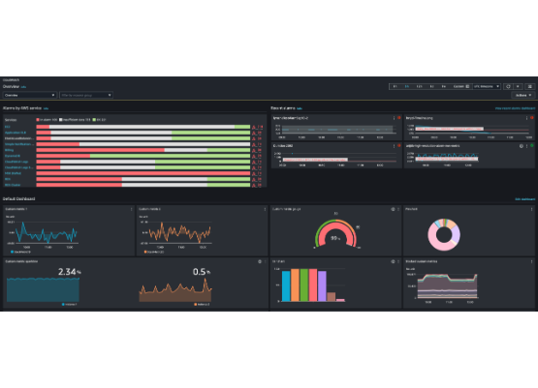
CloudWatch Metrics
Invocations: The total number of times the function was triggered.
Errors: Number of failed invocations due to code or configuration issues.
Duration: Average, min, and max execution time (helps optimize memory).
Throttles: Invocations rejected due to exceeding concurrency limits.
SPEAKER NOTES:

Slide 33
CloudWatch Logs
Every Lambda function automatically streams its standard output (`console.log`, `print`) to Amazon CloudWatch Logs.
View Logs: Organized into Log Groups (by function) and Log Streams (by execution environment).
Debug Code Errors: Easily track down stack traces, exceptions, and custom debug messages.
Retention: Configure log retention policies to save costs on storage.
SPEAKER NOTES:

Slide 34





Troubleshooting Example
The Error
The Cause
The Fix
Client receives a "404 Not Found" or "Missing Authentication Token" when making an HTTP API request.
The API Gateway route is either completely missing, misspelled, or expecting a different HTTP method (GET vs POST).
Verify the route definition in API Gateway, ensure it is linked to the correct Lambda, and critically: deploy the stage.
SPEAKER NOTES:

Slide 35
Module 6
Security Best Practices
SPEAKER NOTES:

Slide 36
IAM Security
Least Privilege Access: Never use wildcard permissions (`*`) in production. Specify exact actions and resources.
Secure Role Policies: One IAM role per Lambda function. Do not share roles across multiple functions.
Resource Policies: Control which external AWS services (like S3) are allowed to trigger your function.
Auditing: Use AWS CloudTrail to monitor when and by whom your function configurations are modified.
SPEAKER NOTES:

Slide 37
Environment Variable Encryption
Protect Secrets
Use AWS KMS
Environment variables are stored at rest securely, but they are visible in plain text inside the AWS Console to anyone with view access to the function.
For sensitive data like passwords or API keys, encrypt the variables using AWS Key Management Service (KMS) or store them securely in AWS Secrets Manager.
SPEAKER NOTES:

Slide 38
VPC Integration
By default, Lambda runs in a secure AWS-managed VPC with internet access.
Access Private Resources: Attach Lambda to your custom VPC to access private RDS databases or ElastiCache clusters.
Secure Networking: Requires specifying VPC Subnets and Security Groups.
Internet Access: A VPC-attached Lambda loses default internet access; requires a NAT Gateway to reach public APIs.
SPEAKER NOTES:

Slide 39
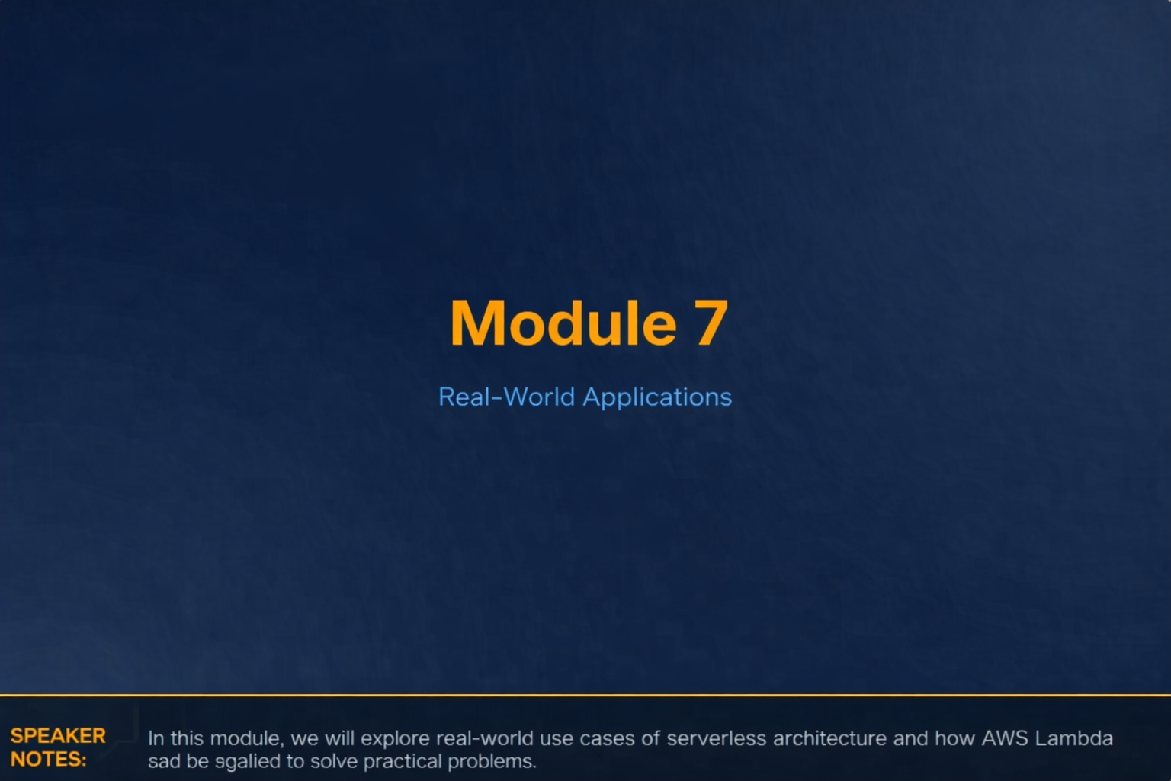

Slide 40

Food Delivery Architecture
Customer App: User submits order.
API Gateway: Routes request securely.
Lambda: Processes order, applies logic.
DynamoDB: Saves order state.
Payment Service: Third-party API invoked.
SPEAKER NOTES:

Slide 41
E-Commerce System (Event Flow)
2. Payment Processing
API Gateway triggers Lambda to handle checkout transaction.
1. Product Upload
3. Order Confirmation
Vendor uploads image to S3; Lambda generates thumbnails.
DynamoDB stream triggers Lambda to send SNS email receipt.
SPEAKER NOTES:

Slide 42


Companies Using Lambda
Netflix
Airbnb
Coca-Cola
Uses Lambda for media processing, encoding files, and managing backup infrastructure.
Relies on Serverless architecture for search infrastructure and asynchronous background jobs.
Migrated vending machine telemetry processing to a highly scalable serverless backend.
SPEAKER NOTES:

Slide 43
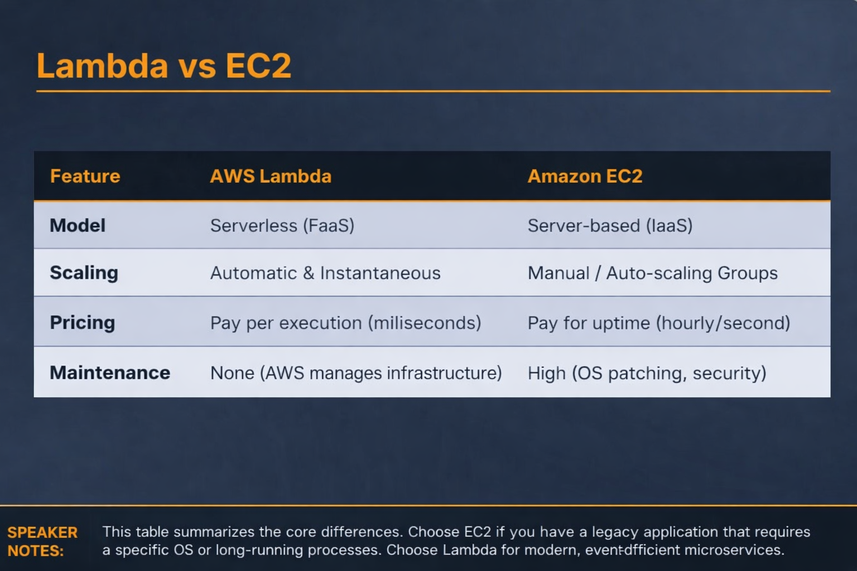

Slide 45
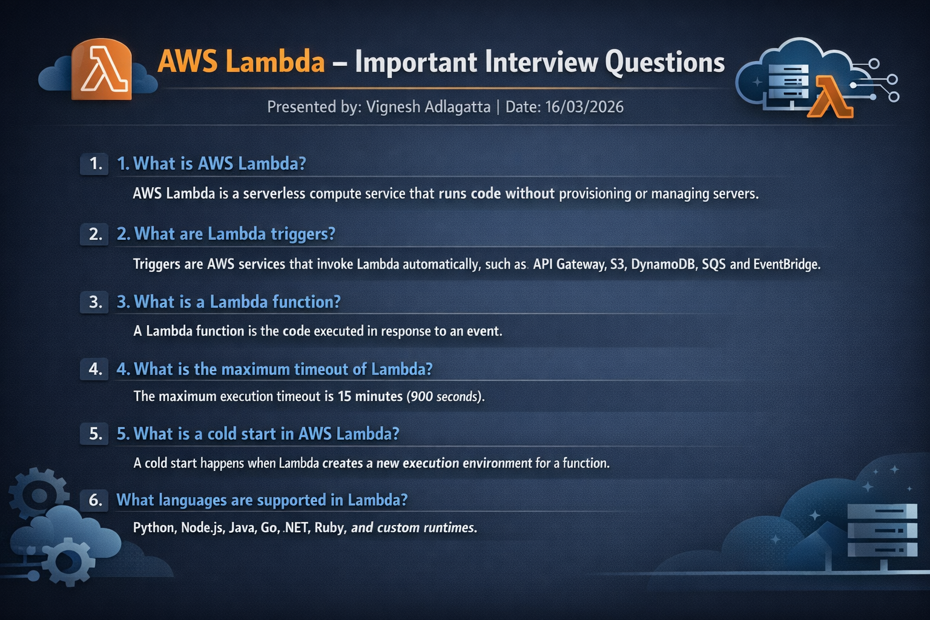

Slide 46
Key Takeaways
Serverless reduces infrastructure management: Focus entirely on your application's business logic.
Lambda scales automatically: Effortlessly handles sporadic and unpredictable traffic without provisioning.
Event-driven systems improve performance: Highly decoupled architectures lead to resilient applications.
Cost optimization: Pay exclusively for the exact compute time your code consumes.
SPEAKER NOTES:

Slide 47
Questions?
Thank you for your time.
SPEAKER NOTES:

Slide 48





Image Sources
https://www.stackscale.com/wp-content/uploads/2020/04/cloud-service-models-iaas-paas-saas-stackscale.jpg
Source: www.stackscale.com
https://d2908q01vomqb2.cloudfront.net/fc074d501302eb2b93e2554793fcaf50b3bf7291/2021/07/20/Serverles-Antipatterns-Example-1.png
Source: aws.amazon.com
https://miro.medium.com/v2/resize:fit:1200/1*WK_-gPDoCp29u8_MfStF7g.png
Source: medium.com
https://docs.aws.amazon.com/images/AmazonCloudWatch/latest/monitoring/images/CW-default-dashboard-update.png
Source: docs.aws.amazon.com
https://cdn.dribbble.com/userupload/42825309/file/original-9d4ec93f3216e5b017cbe5e53393d17e.png?resize=752x&vertical=center
Source: dribbble.com

